Slide 1
From frame to sequence in video scene detection

Slide 2
Table of content
Video scene classification
Frame by frame approach
LSTM-based approach

Slide 3
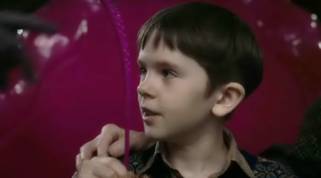
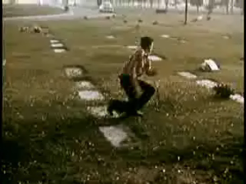
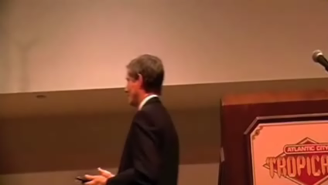
Video scene classification
The HMBD51 data set contains a large human motion database
The data set contains about 7000 clips over 51 classes:
Drink
Run
shake_hands
…
Drink
Run
Shake hands

Slide 4




A possible frame-by-frame approach
Classify each frame using a frame classifier and a pre-trained network
Through majority voting on the frame predictions, obtain the video class
drink
drink
Pretrained CNN
Frame classifier
drink
talk
Drink
drink
Extract frames
Preprocess
Extract features
Classify frames
Classify video
Notes:
The steps for classifying a video using a pretrained network and a frame classifier:
- Extract the video frames
- Preprocess the video frames to match the network’ input size
- Using a pre-trained network extract feature vector from each frame of the video
- Train a classifier that works on a single frame
- Perform the majority voting for a video-based decision

Slide 5












RNN for video scene classification using LSTM
Classify the whole video using a LSTM-based classifier and a pre-trained network
Pretrained CNN
LSTM classifier
drink
Drink
Extract frames
Preprocess
Extract features
Classify video
Notes:
With the use of an LSTM layer, the classifier works on the features extracted from the whole video, and not only from single frame. The temporal information can help in making the decision.

